Slide 1
Personal Income Taxes
Sebastian James
World Bank

Slide 2
Personal Income Tax
Tax on physical persons
Of those who have TAXABLE INCOME -> The Tax Base
Within a certain TAX PERIOD
At a certain RATE
Taxable Income is generally GROSS INCOME less DEDUCTIONS allowed
GROSS INCOME are incomes SUBJECT TO TAX (i.e., does not include EXEMPTIONS)

Slide 3
Definition(s) of income (1)
Standard definition of income of a person by Von Schanz, Haig and Simons (S-H-S) or commonly Haig-Simons definition:
“An Individuals ability to pay taxes”
Income = consumption + change in accumulated wealth (net worth)
Does not distinguish between cash and in-kind income.
For example,
I consumed out of my savings as well as the value of my stock portfolio went up are both included
My employer paid for my health insurance (Fringe benefits)
Gifts
Owning a home versus renting (Imputed Income)
Change in Wealth – Equivalent to Income Tax base

Slide 4
Definition(s) of income (2)
Sources side Definition: Income of one person:
= Labor income (employment income, including fringe benefits + self employment income)
+ Capital income (rents, profits, dividends, interest)
+ Net Transfers (from other individuals, government, foreigners, etc.) including gifts, bequests, alimony, etc.
+ Change in value of existing assets (accrued capital gains/losses in period)
When incomes aggregated across a groups (household members, members of economy, etc.), labor and capital incomes get added up while transfers and changes in value of existing assets get annulled.
That is why these items are not included in Value added, GDI, GNI, & GNDI.
These items are included in income for revenue reasons and create incentive to shift income from high to low tax rates (e.g. gift)

Slide 5
Definition of Income - US Internal Revenue Code (26 U.S. Code § 61)
(a) General definition: Except as otherwise provided in this subtitle, gross income means all income from whatever source derived, including (but not limited to) the following items:
(1) Compensation for services, including fees, commissions, fringe benefits, and similar items;
(2) Gross income derived from business;
(3) Gains derived from dealings in property;
(4) Interest;
(5) Rents;
(6) Royalties;
(7) Dividends;
(8) Alimony and separate maintenance payments;
(9) Annuities;
(10) Income from life insurance and endowment contracts;
(11) Pensions;
(12) Income from discharge of indebtedness;
(13) Distributive share of partnership gross income;
(14) Income in respect of a decedent; and
(15) Income from an interest in an estate or trust.
(b) Cross references For items specifically included in gross income, see part II (sec. 71 and following). For items specifically excluded from gross income, see part III (sec. 101 and following).

Slide 6
Residence vs. Source Principles
Individuals or legal entities are taxable in the country or jurisdiction in which they establish their residence or domicile regardless of the source of income; taxes residents’ world wide income (approximates ability-to-pay principle).
Resident individuals in jurisdiction (typically more than 6 months in year in jurisdiction; or based on economic ties to jurisdiction) or citizens; Resident legal entities/ persons (all corporations, companies, associations, trusts, mutual funds, partnerships, etc. legally established in the jurisdiction), [Permanent Establishment in the case of legal persons]
Citizenship-based taxation In some countries (USA), residence is defined in terms of citizenship rather than the physical residence for natural persons (citizens taxed irrespective of residence) while the legal person is taxed on the basis of its registration or incorporation rather than where it carries out its activities.
The source based or territorial principle recognizes the prior or sole claim of the source country i.e. the country in which the income arises to the natural or legal persons, to tax such income without reference to physical presence or legal residence; taxes income produced by all domestic factors (approximates benefit principle).
Non-Residents are usually taxed on their domestic source income through withholding of payments made to them by Residents

Slide 7
Practical Example - Uganda Income Tax Act
Open the Uganda Income Tax Act
Individual Income Tax
Section 4 (1) and (2) (Page 20 of the document)
Section 6(1)
Third Schedule (Page 129, 130)
Residence
Section 9 (Page 23)
Income
Section 17 (Page 26)

Slide 8
Exempt Incomes
Do not form part of Gross Income
Certain amounts may be exempt for
Social reasons
International Conventions
Structural reasons (double taxation)
Encouraging certain activity (eg. savings)
Example - Uganda Income Tax Act – See Section 21 (Page 31)

Slide 9
Typical Structure of Personal Income Tax
Income (by accounting standard or cash basis)
Minus
Exempt income (typically not reported and hence a problem for tax expenditure accounting)
Equals
Taxable income
Minus
Special deductions
Minus
Standard deduction
Equals
“Tax Table” Income
Apply Marginal Tax Rate Schedule
Tax from MTR schedule
Minus
Tax Credits
Equals
Tax payable/refundable
Minus
Withholding, advance and provisional taxes paid
Equals
Tax balance payable/refundable

Slide 10
US Tax Form 1040
Notes:
Exempt Income does not appear on the form (Example: World Bank Income for non-Americans)
Personal Exemptions
Incomes
Deductions

Slide 11
US Tax Form 1040
Deductions
Tax Calculation
Tax Credits
Notes:
Standard Deduction or Itemized Deduction
Tax Credits vs. Deduction
Other Taxes
Tax Withheld
Tax Owed/Refunds

Slide 12
Marginal Tax Rates – Example Uganda

Slide 13
Marginal Tax Rates – Example
MTR
30%
20%
10%
Basic Exemption
First Bracket
Second Bracket
Third Bracket
Slope = 30%
Tax
Slope = 20%
10%*(X1–X2) + 20%* (X3-X2) + 30%*(X-X3)
Slope = 10%
Taxable income (Y)
10%*(X1–X2) + 20%*(X-X2)
10%*(X-X1)
X1
Taxable income (Y)
X2
X3

Slide 14
How many tax brackets? Flat taxes?
How many tax brackets should be used?
High number of rate brackets adds to complexity without adding much to revenues or progressivity. Many countries have reduced number of brackets to 3 to 5 positive rates aside from “zero bracket” or initial minimum amount of tax free income.
What is minimum number of brackets for progressivity? Two. “Flat tax” structure typically means a large “zero bracket” and one positive rate.
Two critical design issues involve
Zero bracket size? What is minimum taxable amount?
Top rate and income level at which top rate starts?
Need to know income distribution in country to set tax rate structure. Income distributions are typically skewed to right (log-normal distributions) – for example: bottom 40% earn 10% to 15% of income and top 20% earns about 50% of income.
Bulk of tax revenue typically derived from top income earners: 60% to 80% of tax revenue can come from top 20% of earners with a progressive tax structure. Tax revenues are sensitive to top rate and starting income.
Some countries have highly skewed income (Thailand) where almost half the population does not pay any tax and less than 0.05% pay 65% of tax revenues. Situation not very different in most developing countries.

Slide 15
Deriving the Optimal Tax Rate (Laffer Curve)
Find the ‘t’ that maximizes
R(t) = t.Z(1-t),
where Z is the average Taxable Income which is a function of the ‘net-of-tax’ rate (1-t)
At maximum ‘t’,
R’(t) = Z + (t.dZ/d(1-t)).d(1-t)/dt = Z – t.dZ/d(1-t) = 0
dividing throughout by Z,
1 = t.(dZ/d(1-t))/Z
The Elasticity of Taxable Income to ‘net-of-tax’ rate is given by
e = (dZ/Z)/d(1-t)/(1-t) or (dZ/d(1-t))/Z = e/(1-t)
replace (dZ/d(1-t))/Z in the equation above,
1 = t.e/(1-t) or t.e = 1-t or t.e + t = 1, t(1+e) = 1 or,
t* = 1/(1+e)
t*

Slide 16
Income Distribution: Log Normal
skewed to right
Probability of Y
Y_{thresh}
Y_{mean}
Y_{90%}
Y_{50%}
Income, Y

Slide 17
Distribution of Top Incomes
Top 1% income is approximately Pareto distributed
Optimal tax rate based on this distribution implies very high-top tax rates sometimes as high as 70%
Piketty and Saez (2015)

Slide 18
Flat taxes
Flat taxes are typically structured as large standard deduction or zero rate bracket plus one tax rate on all income in excess of large bracket. Tax rate is typically set at some intermediate rate (20% say) rather than rising MTR from low to high rates.
Advantages
Simple structure reduces compliance and administrative costs
Lower top MTR encourages compliance and reduces supply side disincentives
Large standard deduction reduces number of tax filers lowering compliance and administrative costs
Disadvantages
Less progressive
Loses revenue potential with high income earners (Could tax back tax value of large standard deduction.)
Puts higher burden on middle income earners
Requires administrative capacity to check when income rises above standard deduction or businesses are hiding in underground economy
Attractive structure in economies with poor compliance record and/or trying to simplify complex tax system with high rates and many tax breaks. Tried in Russia, former Soviet States, Egypt, etc. Some positive impact especially on compliance but attribution is difficult (other mitigating factors such as increased enforcement).

Slide 19
Taxation/Non-taxation of Savings
Government intervention in this area is to force/encourage savings because people do not save enough
The Social Security system funded by payroll taxes is one way that government force people to save [Detailed analysis is out of the scope of this training]
The other way is to exempt savings from taxation
Does tax exemption for savings affect savings? [[Detailed analysis is out of the scope of this training]
Exemption to savings would encourage savings (substitution effect), but also make a person richer and hence consume more (income effect), the net effect is ambiguous
Increased supply of savings reduce the return from savings and the net effect is less than what one might expect
There are negative welfare effects of taxing savings however when we add uncertainty these welfare effects are reduced
There are significant “behavioral tools” that could encourage saving
(E/T) Exempt/Tax any part of income that is saved (Income-savings=consumption)
However, income that is saved could generate interest income
(E/T) Sometimes this income may be Exempt/Taxed
When this saved Income is withdrawn for consumption
(E/T) The withdrawal from savings may be Exempt/Taxed
There are different models (EEE) is the most generous
(ETT), (TTE) is neutral [In the USA - Roth IRA – (TEE), Tax deferred 401(k) – (EET)]

Slide 20
Taxation of Capital Gains
Capital Gains is the gain from the sale of a capital assets (in most cases)
Capital assets such as property, stocks, bonds, machinery, rights, etc.
In some cases the gains may not be ‘realized’ but still taxed
Example - Germany
However sale price may include inflation and the capital gains would also include a tax on inflation
In many country the purchase prices are indexed to inflation to calculate the capital gain
The rate of taxation could be at the regular rate of taxation of the owner of the asset being taxed
Lower rates are also used in some cases to counteract the tax on inflation and in other cases to improve liquidity of the asset market

Slide 21
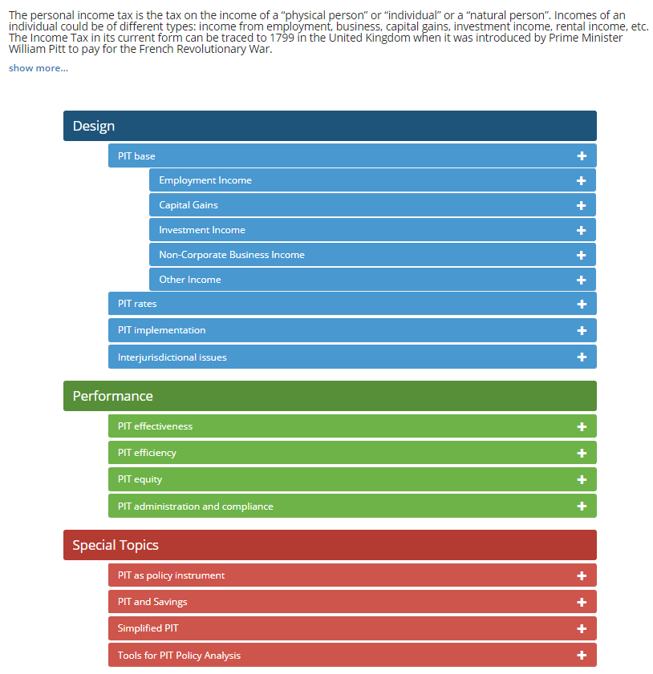
Tax Policy Assessment Framework (TPAF)
Personal Income Tax Module
The TPAF will give a broad coverage of all the major taxes
Currently the VAT Module is live
The PIT Module is ready and will soon be included in the online version
Go to http://github.com/Revenue-Academy/TPAF to download the PIT Module

Slide 22
PIT Practical Session

Slide 23
Requirements
Use IRS Tax Form 1040
Use the line-by-line instructions if necessary
For your itemized deductions use Schedule-A
For Other Income or Deductions use Schedule-1

Slide 24
Status and Incomes
You are filing as Single
You have a spouse and child
Your wages in the US are $70,000
You earned interest of $1,000
$300 of that are from government bonds which are exempt
You put in $5,000 into an Investment Retirement Account (Schedule-1)
You sold shares in Apple for $20,000 (they were bought for $8,000)

Slide 25
Itemized Deductions (Schedule-A)
You incurred Medical Expenses of $5,000
You paid State Income Tax of $2,000
You paid interest on your house mortgage of $10,000
Is this more than your STANDARD DEDUCTION?

Slide 26
Tax Credits and Payments
You are eligible for a child tax credit of $500
$8,000 of tax was withheld by your employer
Estimate your Taxes Due or to be refunded (Page 109 of Instructions for schedule or Page 63 for Tax Tables)

Slide 27
Thank You

